Slide 1
Business Model Canvas
By: Ty Adams | Timothy Thompson | Nathaniel Breeden | David Crouch

Slide 2


E-Commerce Business

Slide 3
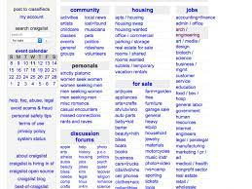
Infrastructure
Key activities: The key activities of craigslist is having a location for people to post, job openings, selling, buying, and services.
Key resources: The Key resource is the website which has all the post able to be searched, to find what you are looking for or allow to sell stuff like cars, and other random things.

Slide 4

Customer segments
Mass market: Craigslist is open to everyone and has many different services, things for sell and things to sell, it is basically like a giant market.

Slide 5
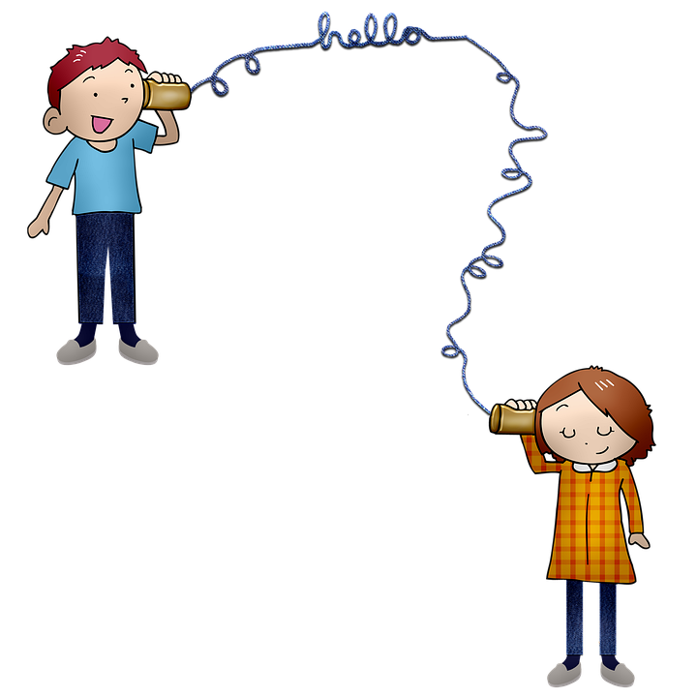
Customer relationships
Craigslist does little more than provide a medium for clients to bridge the gap between supply and demand. Craigslist generally does not put forth effort to maintain any kind of relationship or loyalty from customers.
Craigslist refuses to include banner advertisements on the website in order to avoid detracting from the user experience.
Craigslist uses a self-service model whereby it provides tools needed for the customers to serve themselves easily and effectively.

Slide 6
Cost structure
Craigslist is value driven, believing in the philosophy “Network First, Profit Later.”
IT maintenance and payment processing are the most important costs.

Slide 7

Revenue streams
Craigslist charges a fee for job postings tiered at $10, $15, $25, $35, $45, and $75. I.e., Charleston, WV has a fee of $10 while San Francisco has a fee of $75. These fees were implemented to cut down on spam postings in job listings.
Craigslist is considering to include banner advertising or Google text ads.
The company has yet to return a profit, only making enough to cover operating costs.

Slide 8
Gains
Craigslist classifieds are cheaper and last longer than classifieds in newspapers.
Classifieds are listed by region to make looking for local bargains easier.
Ads can be easily edited and removed if needed.

Slide 9

Questions?

Slide 10
References
Patrick, K. (n.d.). How Craigslist makes money. Retrieved from: https://smallbusiness.chron.com/craigslist-money-27287.html
Craigslist. Betterteam. (n.d.). https://www.betterteam.com/craigslist.
Pitchengine. (2020). Craigslist business model: the go to website for classifieds. Retrieved from: https://pitchengine.co/business-models/craigslist-business-model-the-go-to-website-for-classifieds/

